Slide 1
Chapter 4: Threads

Slide 2
Chapter 4: Threads
1.1 Overview
1.2 Multicore Programming
OBJECTIVES
To introduce the notion of a thread—a fundamental unit of CPU utilization that forms the basis of multithreaded computer systems

Slide 3
Thread
Thread: a basic unit of CPU utilization;
It composes of:
        Program counter
        Set of registers
        Stack
A thread has its own thread ID.
Thread shares the following items with other threads that are created in the same process:
        code section
        data section
        Other operating system resources

Slide 4
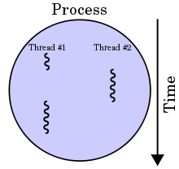
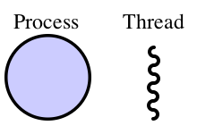
4.1.1 Motivation
Most modern applications are multithreaded
Threads run within application
Multiple tasks with the application can be implemented by separate threads
  Update display
  Fetch data
  Spell checking
  Answer a network request
Process creation is heavy-weight while thread creation is light-weight
Can simplify code, increase efficiency
Kernels are generally multithreaded

Slide 5
Multiple actions executing simultaneously
  Heavyweight process (traditional process)
    Owns the resources
    Passive element
  Lightweight process (Thread)
    Uses CPU and scheduled for execution
    Active element
  Multithreaded applications programs
    Contain several threads running at one time
    Same or different priorities
    Examples:
      Web browsers and time-sharing systems
Processes with multiple subprocesses
Proces with multiple threads

Slide 6
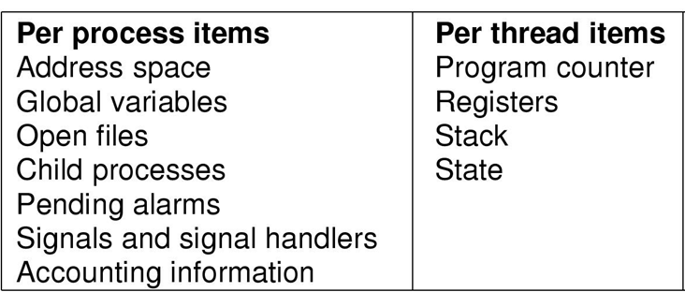
Components of Threads vs. Process
Items shared by all threads in a process
Items private to each thread

Slide 7
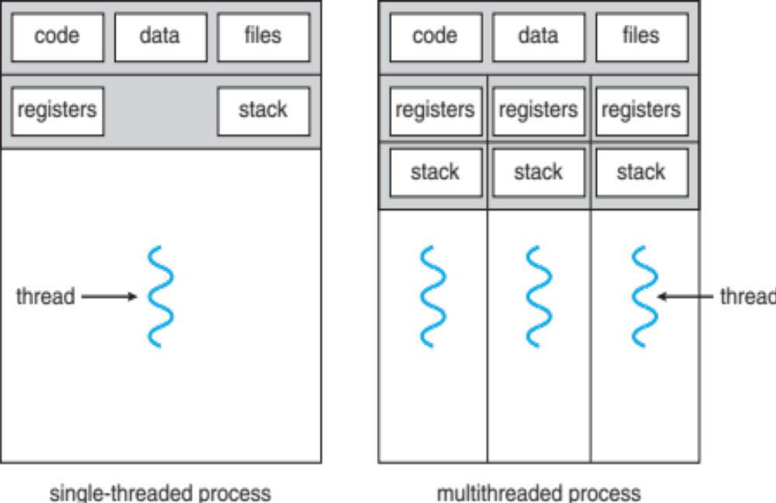
Single and Multithreaded Processes
Figure 4.1

Slide 8
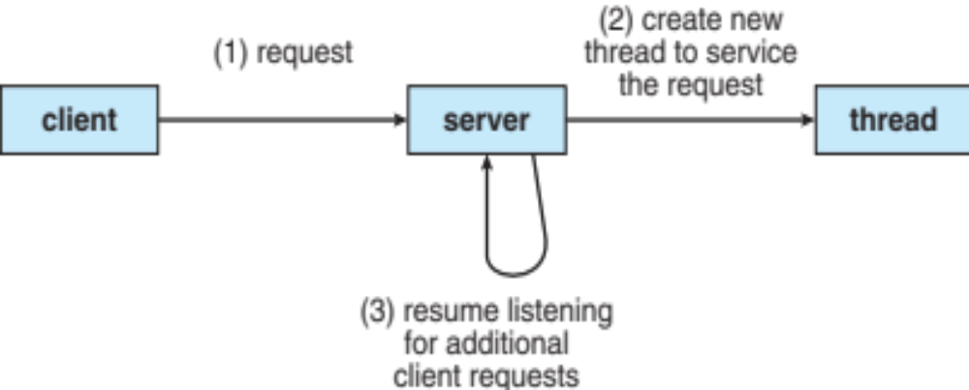
Multithreaded Server Architecture
Figure 4.2 Refer to page164-165

Slide 9
Applications
Use by many software packages that run on modern desktop PCs.
Word Processor | a thread for displaying graphic, another thread for reading keystrokes
Web browser | one thread displays image or text, while another thread retrieves data from the network
Web server | when server receives a request, a thread will be created to service that request

Slide 10
4.1.2 Benefits
Responsiveness – may allow continued execution if part of process is blocked, especially important for user interfaces.
Resource Sharing – threads share resources of process, easier than shared memory or message passing.
Economy – cheaper than process creation, thread switching lower overhead than context switching.
Scalability – process can take advantage of multiprocessor architectures.

Slide 11
4.2 Multicore Programming
Multi-CPU systems. Multiple CPUs are placed in the computer to provide more computing performance.
Multicore systems. Multiple computing cores are placed on a single processing chip where each core appears as a separate CPU to the operating system
Multithreaded programming provides a mechanism for more efficient use of these multiple computing cores and improved concurrency.
Consider an application with four threads.
  On a system with a single computing core, concurrency means that the execution of the threads will be interleaved over time.
  On a system with multiple cores, however, concurrency means that some threads can run in parallel, because the system can assign a separate thread to each core

Slide 12
Multicore Programming (Cont.)
There is a fine but clear distinction between concurrency and parallelism.
A concurrent system supports more than one task by allowing all the tasks to make progress.
In contrast, a system is parallel if it can perform more than one task simultaneously.
Thus, it is possible to have concurrency without parallelism

Slide 13
Multicore Programming (Cont.)
Types of parallelism
  Data parallelism – distributes subsets of the same data across multiple cores, same operation on each
  Task parallelism – distributing threads across cores, each thread performing unique operation
As number of threads grows, so does architectural support for threading
  CPUs have cores as well as hardware threads
  Consider Oracle SPARC T4 with 8 cores, and 8 hardware threads per core

Slide 14
Multicore Programming
Multicore or multiprocessor systems are placing pressure on programmers. Challenges include:
  Dividing activities
  Balance
  Data splitting
  Data dependency
  Testing and debugging
Parallelism implies a system can perform more than one task simultaneously
Concurrency supports more than one task making progress
  Single processor / core, scheduler providing concurrency

Slide 15
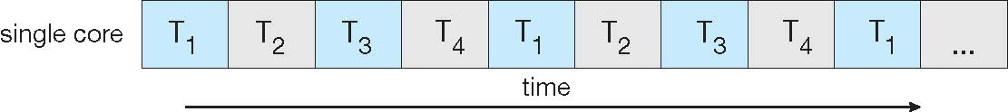
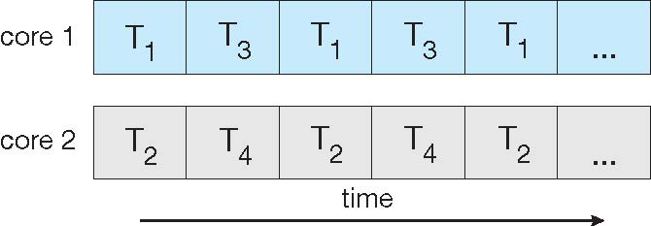
Concurrency vs. Parallelism
Concurrent execution on single-core system:
Parallelism on a multi-core system:
Figure 4.4

Slide 16

Concurrency
In a uniprocessor multiprogramming system:
  Execution of processes / threads are interleaved in time to yield the appearance of simultaneous execution;
  Known as concurrent processes / threads execution;
  Note that actual parallel processing does not occur;

Slide 17
Interleaving
P1
P2
P3
Time

Slide 18
Multiprocessor system:
  Overlapping and interleaving of processes execution;
  Parallel processing sometime occurs;
P1
P2
P3
Time

Slide 19
Concurrency arises / occurs in three different contexts*:
Multiple applications | Multiprogramming was invented to allow processing time to be dynamically shared among a number of active applications.
Structured application | Application can be a set of concurrent processes.
Operating-system structure | Operating system is a set of processes or threads. Example: Solaris and Linux (MS-DOS – no concurrency)
__________________________________
* Stalling, W. Operating Systems: Internals and Design Principles (5th Edition). Prentice Hall. (2005)

Slide 20
Interleaving and overlapping execution of processes can be viewed as examples of concurrent processing;
  → Need control synchronization and data access synchronization (Chapter 6).
Both present the same problems such as in sharing global resources. Example:
  Global variables;
  Shared files or data bases;
  Managing the allocation of resources optimally such as the request use of a particular I/O device (may lead to deadlock);

Slide 21
Another Example of Concurrency
Two or more threads need access to a shared resource that must be used by only one thread at a time
  Eg. When one thread is writing to a file, a second thread must be prevented from writing to the file at the same time.

Slide 22
Concurrent Programming
Concurrent processing system
  One job uses several processors (multiprocessors)
  Executes sets of instructions in parallel
  Requires programming language and computer system support

Slide 23
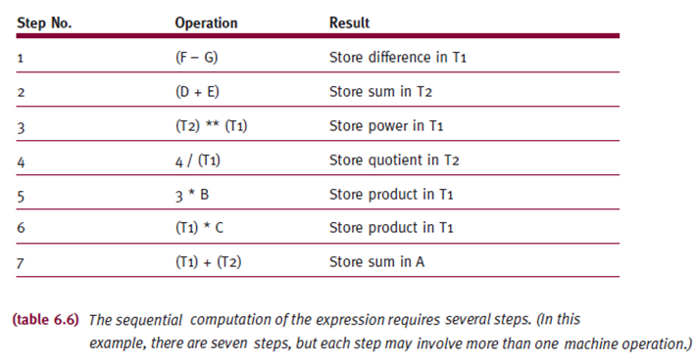
Applications of Concurrent Programming
A = 3 * B * C + 4 / (D + E) ** (F – G)
Uniprocessor
(Sequential Computation)

Slide 24
A = 3 * B * C + 4 / (D + E) ** (F – G)
Steps | Operation
1 | A = 3 * B * C + 4 / (D + E) ** T₁
2 | A = 3 * B * C + 4 / T₂ ** T₁
3 | A = 3 * B * C + 4 / T₁
4 | A = 3 * B * C + T₂
5 | A = T₁ * C + T₂
6 | A = T₁ + T₂
7 | A
Uniprocessor
(Sequential Computation)

Slide 25
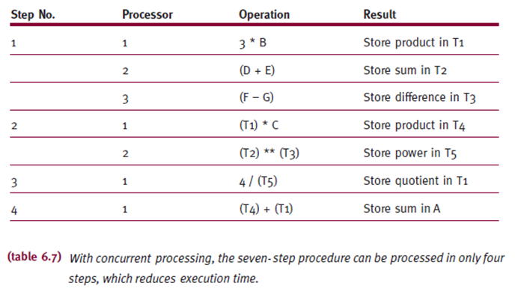
Multiprocessor
(Concurrent processing)
A = 3 * B * C + 4 / (D + E) ** (F – G)

Slide 26
1
2
3
A = 3 * B * C + 4 / (D + E) ** (F – G)
Steps | Processor | Operation
1 | 1 | A = T₁ * C + 4 / (D + E) ** (F-G)
 | 2 | A = T₁ * C + 4 / T₂ ** (F-G)
 | 3 | A = T₁ * C + 4 / T₂ ** T₃
2 | 1 | A = T₄ + 4 / T₂ ** T₃
 | 2 | A = T₄ + 4 / T₅
3 | 1 | A = T₄ + T₁
4 | 1 | A
Multiprocessor
(Concurrent processing)

Slide 27
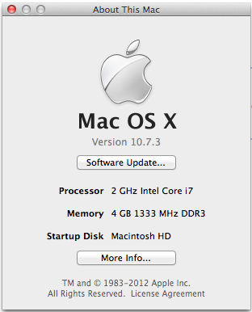
EXAMPLE:
Screenshot from MacBook Pro

Slide 28
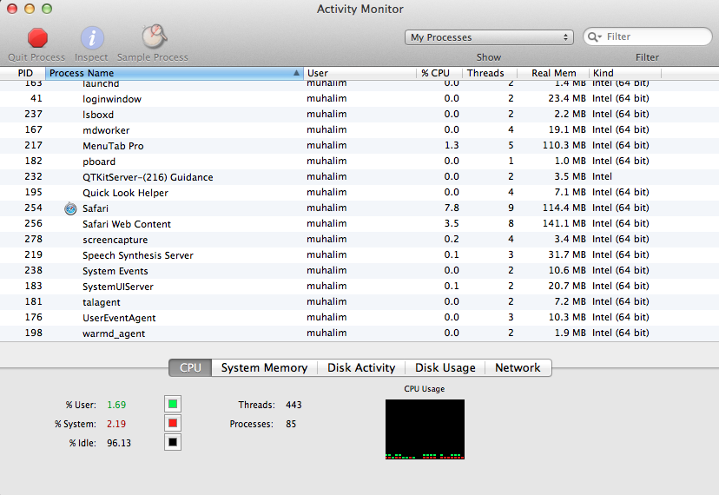

Slide 29
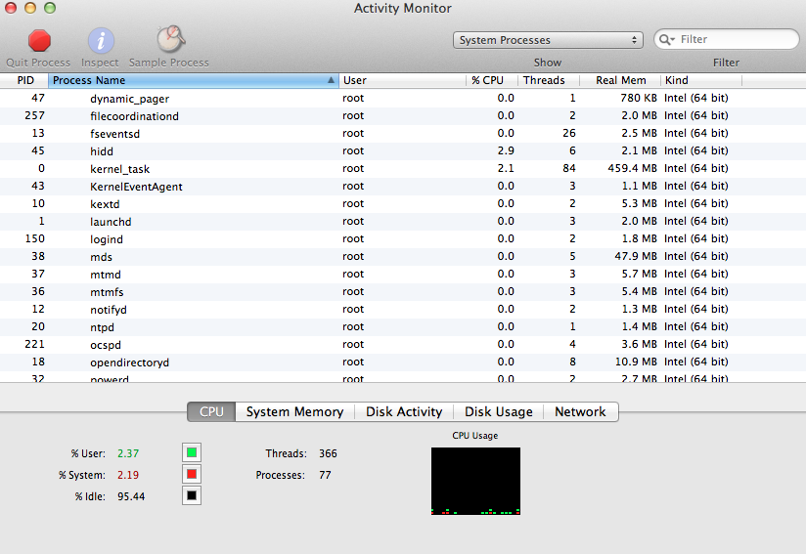

Slide 30
EXERCISE
From Silberchatz, Operating System Concepts Chapter 4 Exercises
Odd number Matric card – 4.3, 4.5
Even number Matric card – 4.2, 4.4
Due date: Submit to e-learning 5 days after the end of the lecture.

Slide 31
End of Chapter 4

